Slide 1
EDA On Nifty50 Companies
Nifty 50 is a or a basket of the 50 most active stocks on the NSE. .
The stocks in Nifty 50 index keeps on changing.
These nifty 50 have stocks from all 13 major sectors of economy

Slide 2
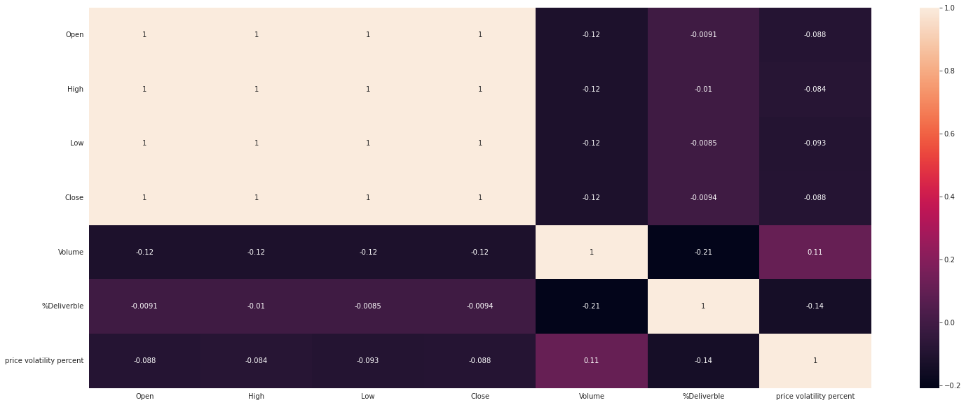
Corelation between variables
A positive correlation shows both variables moves in same direction
A negative correlation shows both variables moves in opposite direction
Zero correlation means there is no relation at all

Slide 3
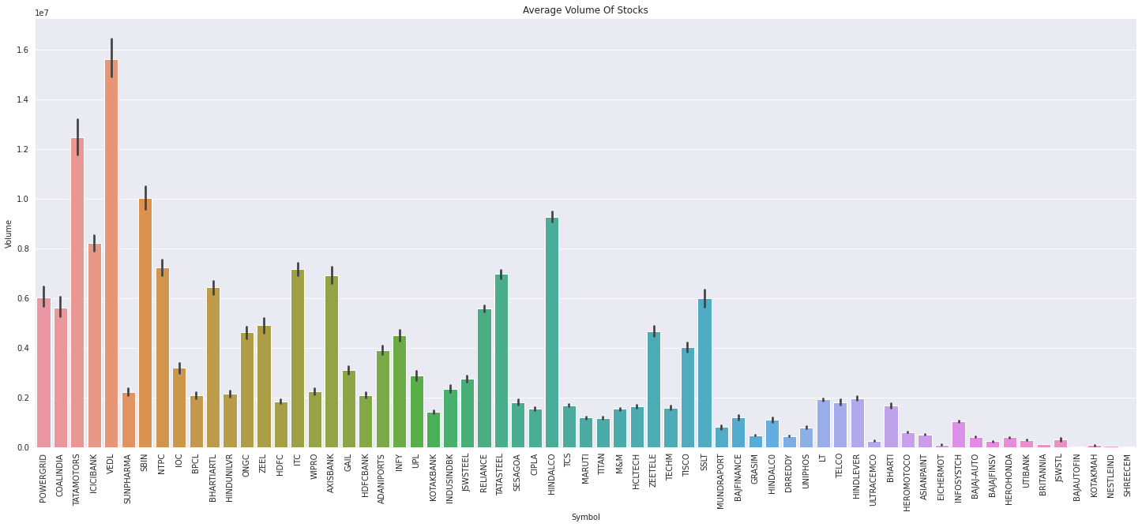
Average Volume Of Stocks
IN below bar chart We can see average volume of stocks with their volume volatility.
More the volume it means more people are trading in that stock and it has high liquidity that makes it easy to buy and sell.
High volume stocks are good for intraday trading.
High volume indicates more interest in the stock and the presence of buyers and sellers in that stock. When the stock is in an uptrend, and there is an increase in volume along with the ongoing uptrend, the stocks will continue to go up. It indicates that more and more buyers are interested in buying that stock.

Slide 4
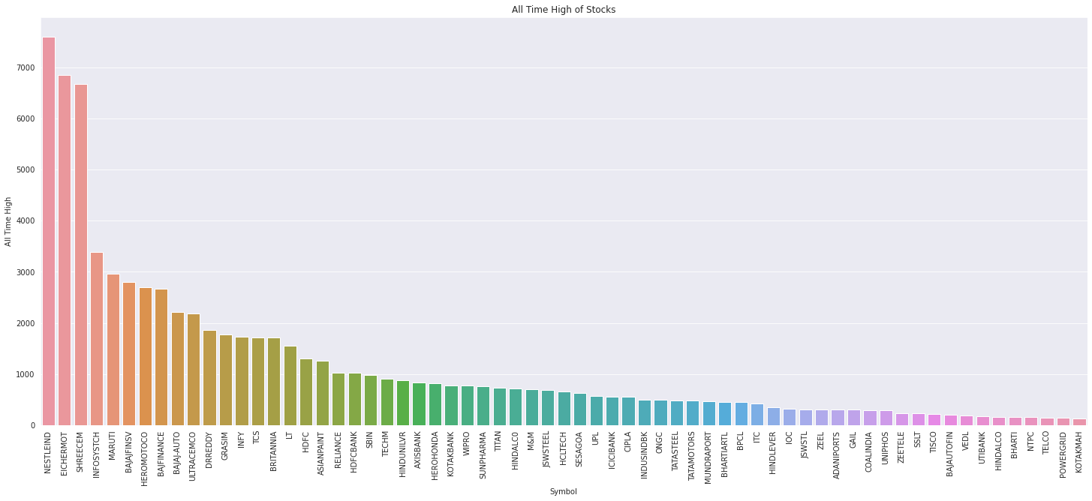
All time high of stocks
The highest price at which the stock was traded is known as all time high.
Here we can see the highest traded price (till the data available ) of Eicher Motors is near 340000 .

Slide 5
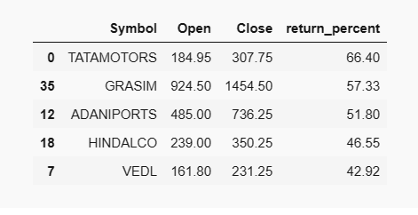
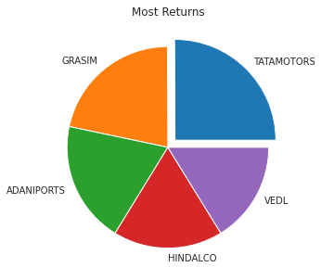
Stocks Which Have Given Max Return In 2021
As we can see Tata Motors has given max return 66.40%.

Slide 6
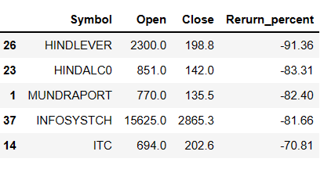
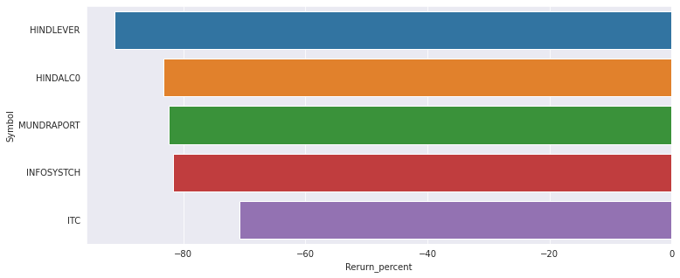
Stocks which have given max loss
Here we can see in all these years HINDLEVER has given max loss followed by HINDALCO and MUNDRAPORT.

Slide 7
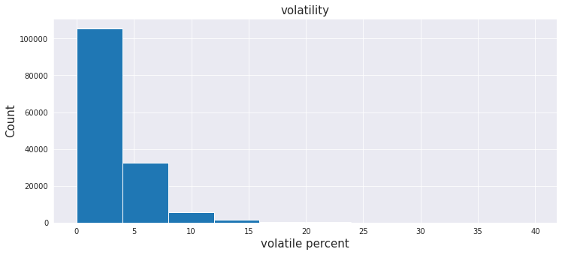
Volatility Range of Market
Market volatility is the frequency and magnitude of price movements, up or down. The bigger and more frequent the price swings, the more volatile the market is said to be.
As we can see most of the times volatility is between 0 to 5%.The number of times when volatility is above 10% is very less.

Slide 8
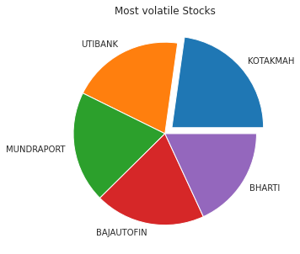
Most volatile Stocks
Stock volatility is the frequency and magnitude of price movements, up or down. The bigger and more frequent the price swings, the more volatile the Stock is said to be.
Volatility of a stock is the percentage difference between the low price and high price of a stock for the day.
Higher the volatility of a stock is, the riskier the security will be. Volatile stocks are stocks that are simply considered to be highly risky and fluctuate in value more than other investments.
Here we can see KOTAKMAH is the most volatile stock in these years with the average volatility of 5.73% followed by ZEETELE and UTIBANK.

Slide 9
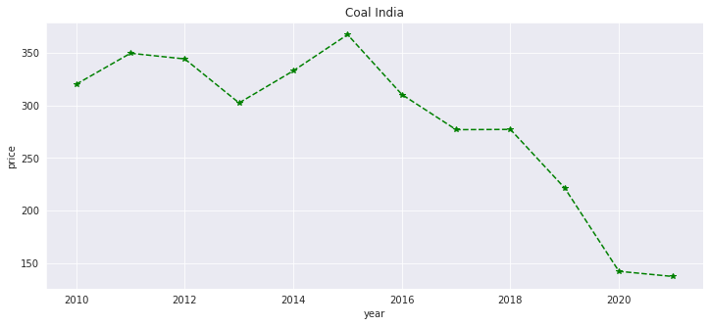
what is coal India stock doing ?
Here we can see coal India is going in downtrend from the year 2015 but it has become constant from the year 2020.

Slide 10
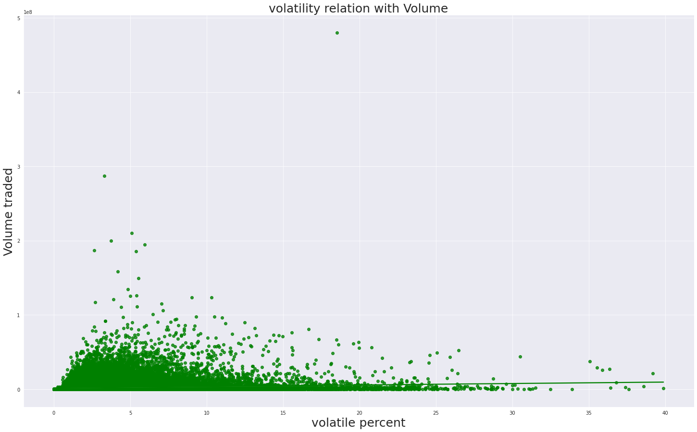
Does a high volatile stock have high volume also ?
As we can through this regression plot even if the price volatility percent increases there is no change in volume with respect to volatility.
Clearly volume traded is independent of price volatility

